Slide 1
Developing methods for evidencing social enterprise as a public health intervention
Project 1: An historical perspective on social enterprise as a public health intervention
Dr Gillian Murray
Yunus Centre of Social Business and Health

Slide 2
Project Team
Dr Gillian Murray History
Prof Rachel Baker Health Economics
Alan Kay Community and Social Enterprise Researcher
Carole MaCallum University Archivist

Slide 3
My research background
A broad range of topics within Modern British History, including:
Women’s lives and domestic service in 18th century Edinburgh
Regional television news in the English Midlands in the 1950s and 1960s
Lacemaking in Nottingham from the 1960s to the present day
Researching these topics has consistently led to:
Exploring previously unexamined archival material
Drawing new connections between distinct areas of research
Notes:
Is this necessary? I thought it might be valuable in terms of building up a relationship with the KE Forum –might be more willing to help if they know where a bit about my interests and enthusiasm for the project?

Slide 4
Project aims
The main aims of the project are to:
Research the intersections between the parallel histories of social enterprise and public health, explore connections and provide a new perspective on this important aspect of Scottish history.
Develop a dialogue between the past and the present in the field of social enterprise and health, producing a history that is more than dormant background but an active evidence base in current and future research
The study of history broadens the mind. It exposes the student to the full range of human possibilities, only a small sampling of which is available in the present...the limited range of present-day values and behaviours ought not to constrain the contemporary imagination of what is possible for the future.
(Peter Mandler, History and National Life, 2002)

Slide 5
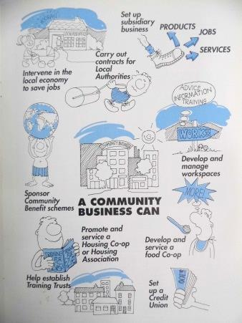
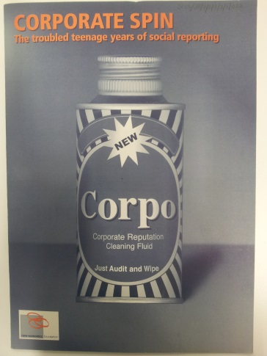
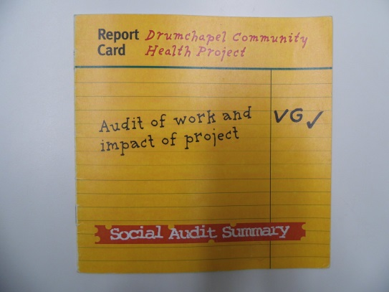
Archival research
Archival research will provide…
The first systematic investigation of the Social Enterprise Collection (Scotland) (SECS)
Contribute to the cataloguing of the John Pearce papers, donated to GCU upon his retirement in 2010
Insight into social enterprises, the social auditing process, supporting networks and policies
Notes:
I will discuss the types of documents available to flesh out what this aspect of the research involves and provide a couple of anecdotal examples from my findings so far

Slide 6
Scottish Community Enterprise Investment Fund (1989)

Slide 7
Drumchapel Community Health Project (2000)

Slide 8
Rural Environmental Action Project (2000-2001)

Slide 9
New Economics Foundation, 2000

Slide 10
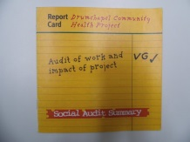
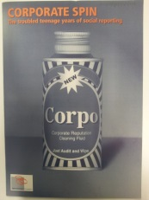
Archival Research
Social Enterprise initiatives
Social Enterprise support networks
Policy networks

Slide 11
Oral History interviews
Oral History interviews will provide…
A lasting record of the voices of interviewees and their perspective on social enterprise and health
Begin to fill the gaps in the archival material
Expand on new research themes identified by the project
Who would you interview? What questions would you ask?
What kinds of memories are important to capture?
Notes:
I will briefly explain the difference between an oral history interview and interviews as usually used in social science research
Do we want to invite more names to our list of potential interviewees?

Slide 12
Making connections
What we know?
We know that social enterprises were initiated to address a wide range of issues and interests in rural and urban communities across Scotland:
Housing, Employment, Education, Health Care, Recreation, Transport
What we don’t know? …yet!
Even when social enterprise initiatives did not explicitly intend to address public health issues did they improve health and wellbeing in their areas?
By exploring how these initiatives operated can we use the history of social enterprise as a lens to examine what communities understood as important to their health?

Slide 13
Outcomes
Move beyond the established medical view of public health history…
Uncover the relationship between communities and their health through the practice of social enterprise and how this has changed over time
Produce community-centred determinants of public health…
Reveal how social enterprise could provide a means to restore community participation and engagement in areas where resources for maintaining collective health had been diminished
Establish WHAT was effective? WHERE? WHEN? and WHY?
Notes:
I’ll find some more images to include in these slides, it’s maybe looking a bit texty?!

Slide 14
Questions for the Forum
Looking back, is the history of social enterprise in Scotland one of continuity or change?
From your own experience, do you see connections between social enterprise and improved health and wellbeing?
Or, do you see these as very separate entities?
What do you think is important for this history project to cover; whose story needs to be told?
Gillian.Murray2@gcu.ac.uk
Notes:
Do you think these hit the mark? Too many questions?

